Slide 1
Graph Neural Networks
Grace Reed
6/8/26

Slide 2
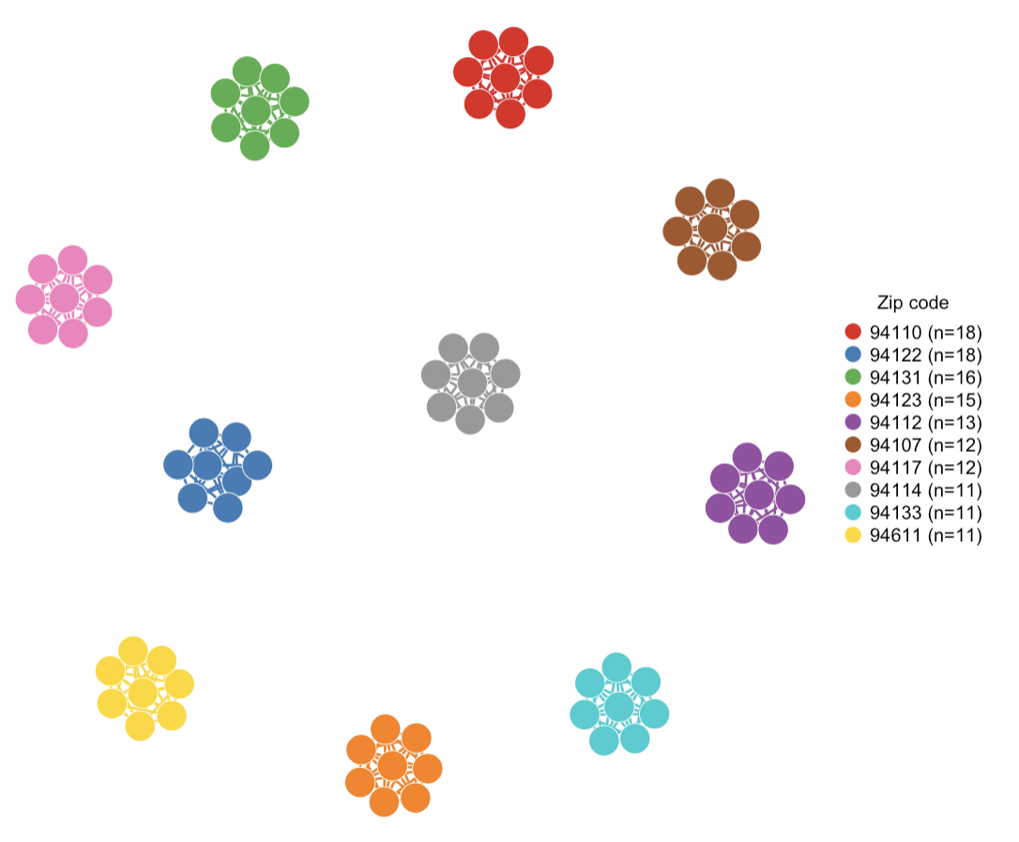
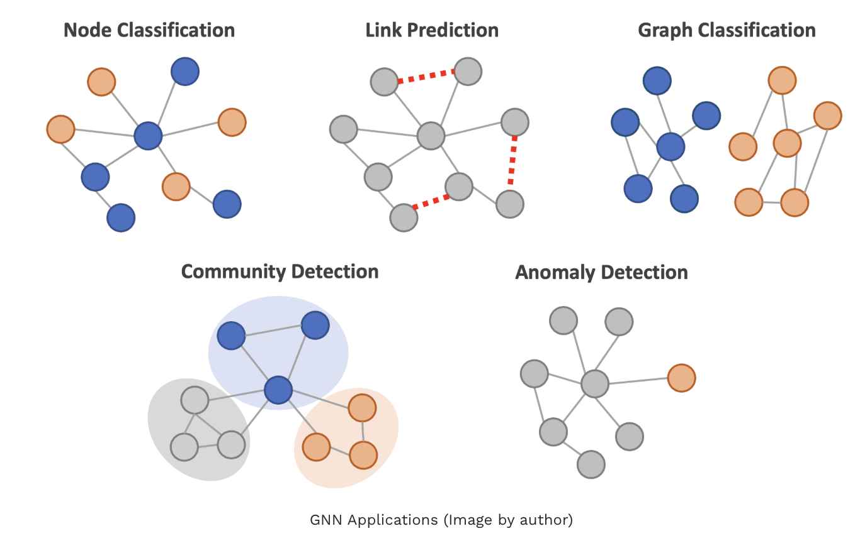
Description & Applications
A deep learning model designed to work with graph-structured data, where information is presented as nodes and edges.
Useful for tasks like network analysis, molecule prediction and recommendation systems.
learns both node-level and graph-level patterns

Slide 3
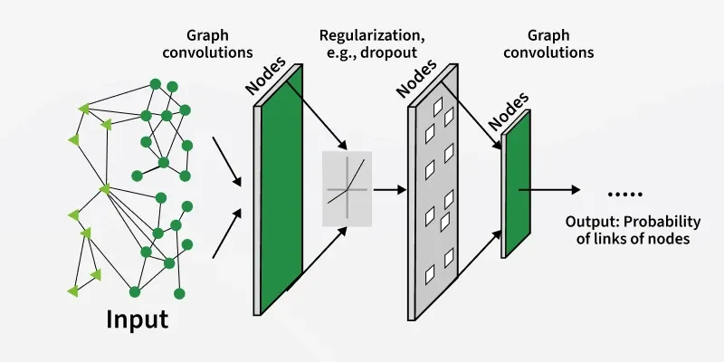
Step | Explanation
1. Load the data | G =(V,E)
2. Define the GNN layers. | A GNN layer usually follows a message-passing pattern: each node gathers information from its neighbors, aggregates it, and then updates its own embedding. Stacking multiple layers lets the model capture information from farther away in the graph, with each layer extending the receptive field by one hop
3. Forward pass. | Run the node features through the GNN layers to produce embeddings, then use those embeddings to make predictions for the task at hand. The forward pass is where the model computes outputs from the current weights and graph structure.
4. Train the model | Compute a loss between predictions and targets, then use gradient descent or SGD to update the learnable parameters. For supervised node classification, cross-entropy is a common loss
5. Evaluate the model. | Test the trained model on held-out data and measure performance with metrics such as accuracy, F1, or AUC depending on the task. Evaluation checks how well the learned embeddings generalize to unseen nodes, edges, or graphs.

Slide 4
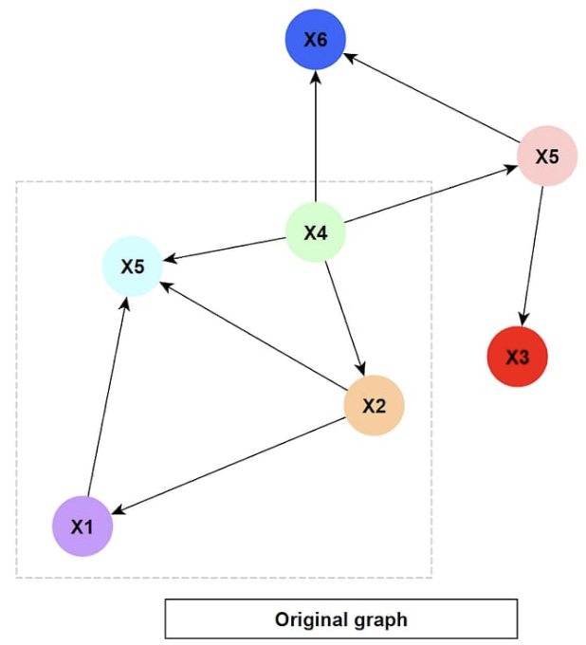
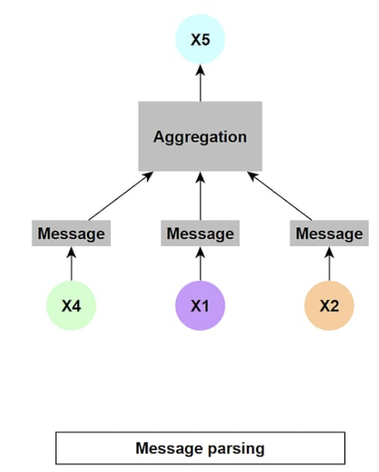
2. Define the GNN layers
Build layers that perform message passing.
Each layer lets a node gather information from its neighbors.
Stacking layers expands the model’s view to farther-away nodes.

Slide 5
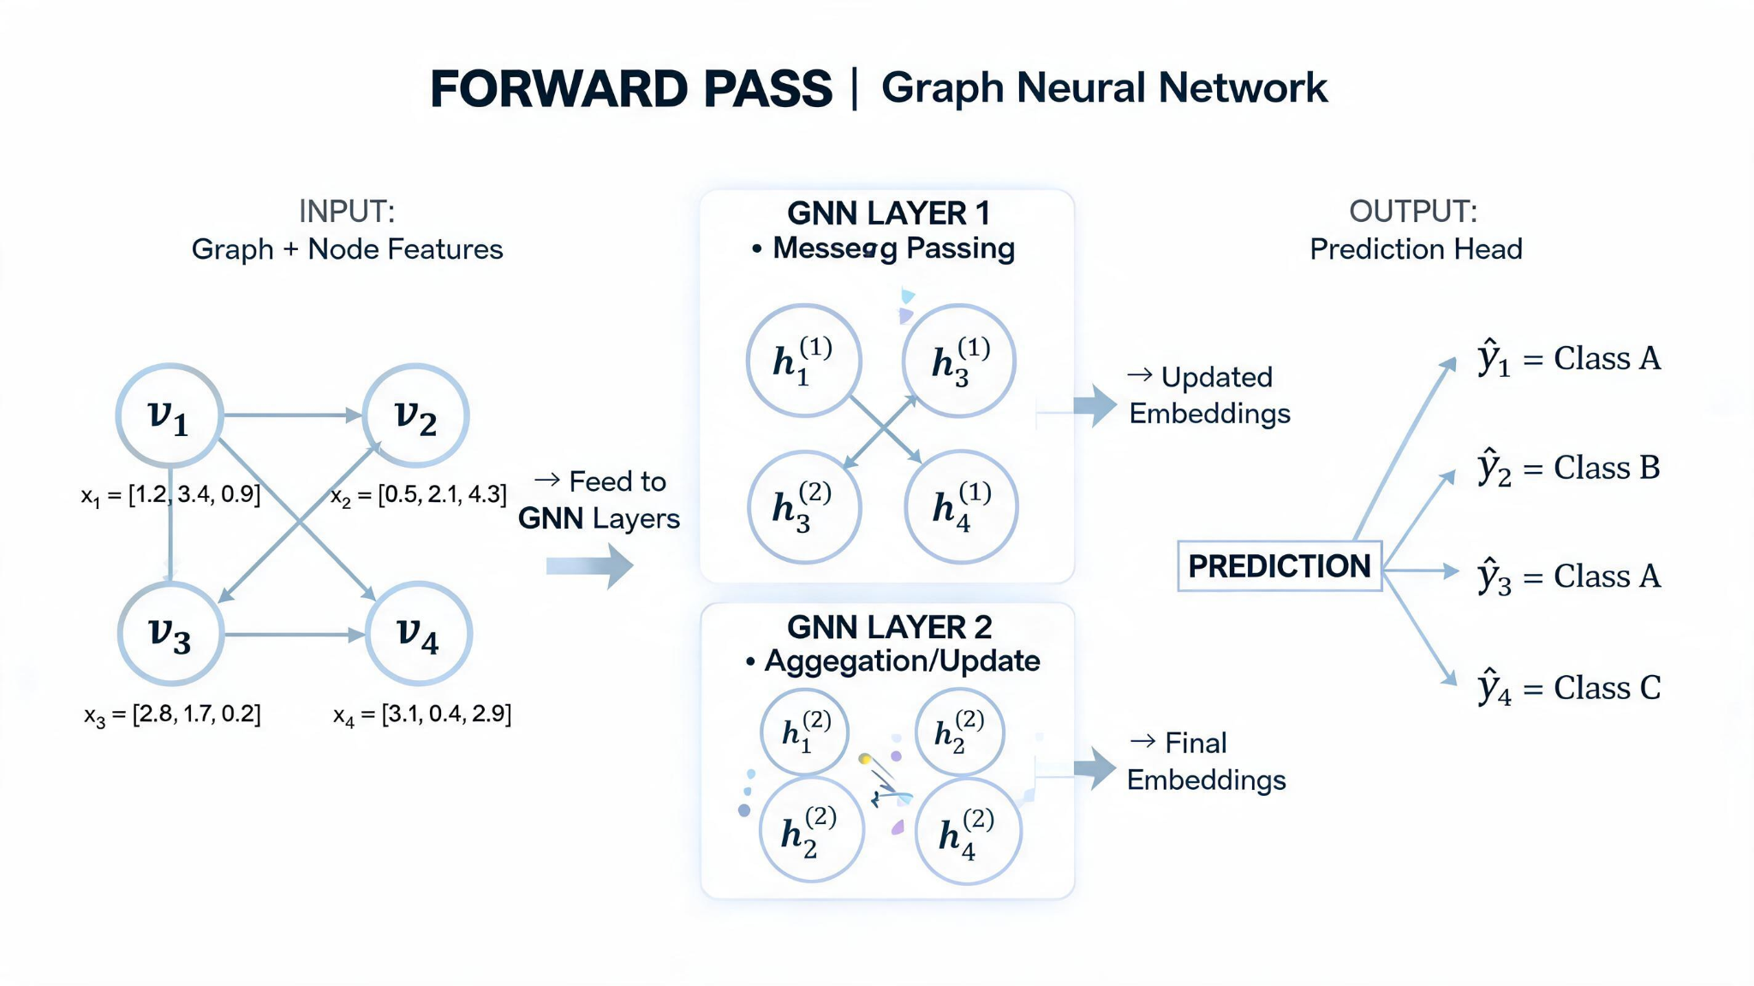
3. Forward pass
Send node features through the GNN layers.
Each layer updates node embeddings based on neighbor information.

Slide 6
4. Train the model
Compare predictions with the true labels using a loss function.
Backpropagate the error and update the weights
Repeat for multiple epochs until performance improves
True labels: [0, 1, 2, 1, 0 ]
Predicted: [0, 1, 2, 2, 0 ]
✓ ✓ ✓ ✗ ✓
Cross-Entropy Loss = -Σ y_true · log(y_pred)
= 0.85 ← lower is better
Epoch 1 → Loss: 1.94 | Accuracy: 42%
Epoch 10 → Loss: 1.21 | Accuracy: 65%
Epoch 50 → Loss: 0.63 | Accuracy: 78%
Epoch 100 → Loss: 0.41 | Accuracy: 85%
Epoch 200 → Loss: 0.28 | Accuracy: 91%
↓ loss ↑ accuracy
loss.backward() # compute gradients
optimizer.step() # update all weights W
W_new = W_old - lr · ∇Loss
= W_old - 0.01 · ∇Loss

Slide 7
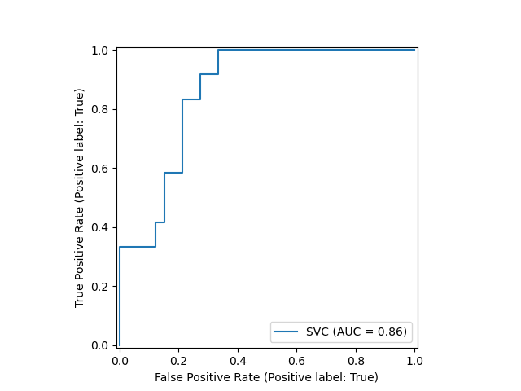
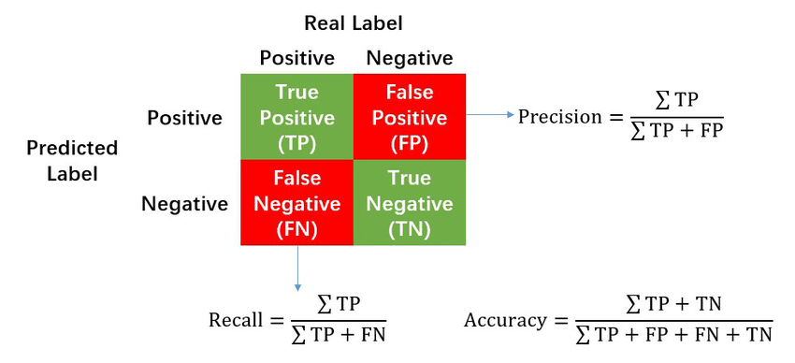
5. Evaluate the model
- Accuracy → for balanced node classification
- F1 Score → for imbalanced class distributions
- AUC → for ranking/link prediction tasks
Test on held-out nodes (test_mask) the model has never seen during training.
Result: Accuracy = 91% shows: Out of the test_mask nodes it had never seen during training → it correctly classified 91 of every 100

Slide 8
Convolutional Neural Network
Graph neural network
Input: Regular grid. Every pixel has the same neighbors.
Image as a Pixel Grid Matrix
Input: Irregular graph. Each node can have any number of neighbors.
Graph as Node Features + Edge List
graph.x (3×5×5 tensor — RGB image, 5×5 pixels)
Channel R:
[[120, 130, 125, 118, 110],
[135, 140, 128, 122, 115],
[118, 125, 132, 140, 138],
[110, 115, 120, 130, 135],
[105, 112, 118, 125, 128]]
Channel G:
[[ 80, 85, 90, 88, 82],
[ 78, 92, 95, 89, 84],
[ 85, 90, 96, 98, 92],
[ 82, 88, 91, 95, 90],
[ 79, 83, 87, 91, 88]]
Channel B:
[[200, 198, 195, 192, 188],
[202, 205, 200, 196, 190],
[198, 202, 208, 205, 200],
[195, 198, 202, 208, 205],
[190, 195, 198, 202, 206]]
graph.x (5×4 tensor — 5 nodes, 4 features each)
feat_0 feat_1 feat_2 feat_3
node_0 [ 0., 1., 0., 1. ]
node_1 [ 1., 0., 1., 0. ]
node_2 [ 0., 0., 1., 1. ]
node_3 [ 1., 1., 0., 0. ]
node_4 [ 0., 1., 1., 0. ]
graph.edge_index.T (edges — connected node pairs)
tensor([[ 0, 1],
[ 0, 2],
[ 1, 3],
[ 2, 3],
[ 2, 4],
[ 3, 4]])

Slide 9
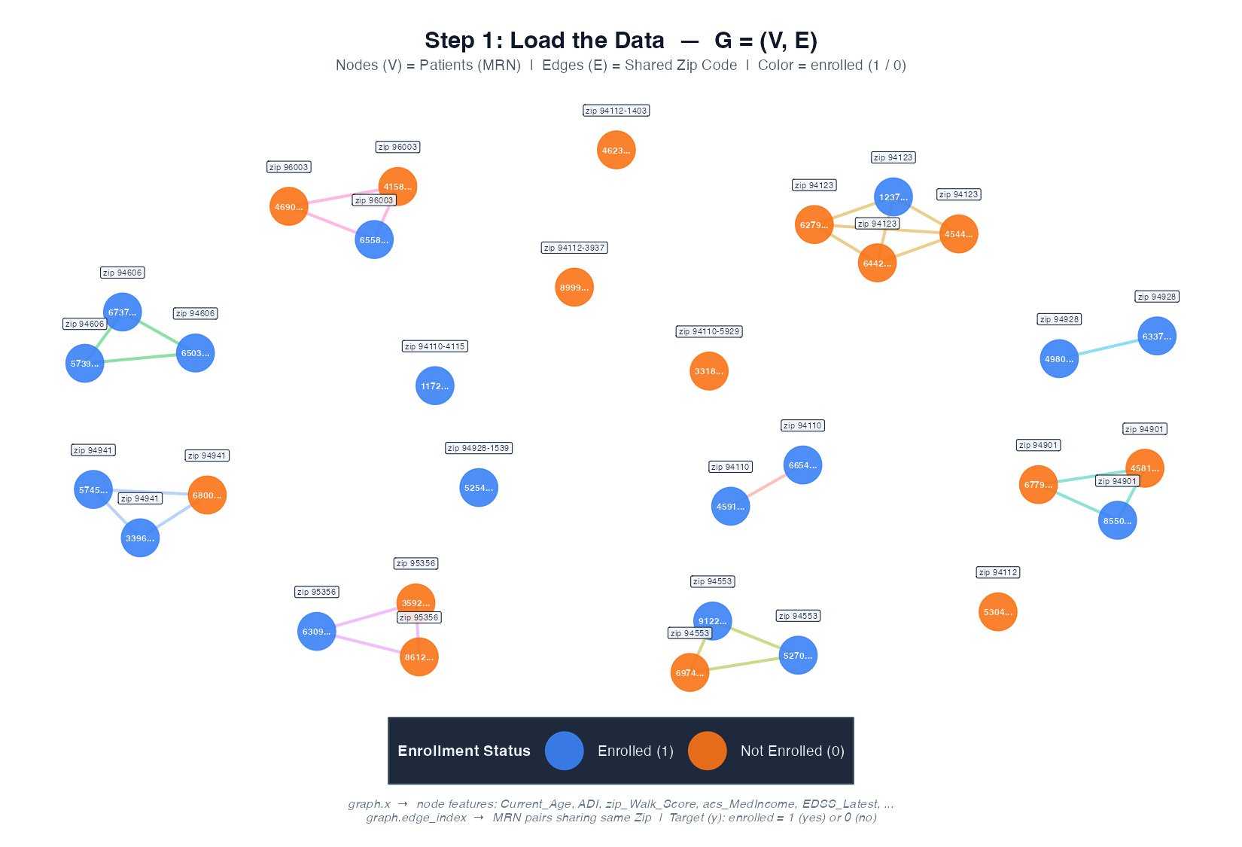
Example
Nodes (V) = 1,399 patients
Patient Age ADI Walk Enrolled
node_0 [50693, 55.2, 1.09, 7, ? ]
node_1 [20843, 54.6, -2.34, 58, ? ]
node_2 [44485, 51.7, 2.65, 70, ? ]
...
node_1398 [64120344, 68.6, ...]
Edges (E) = patients sharing the same zip code
graph.edge_index.T:
tensor([[patient_2, patient_4], # both in zip 94806
[patient_1, patient _5], # both in zip 94619
[patient_3, patient _6], # both in zip 94131
...])

